Slide 1
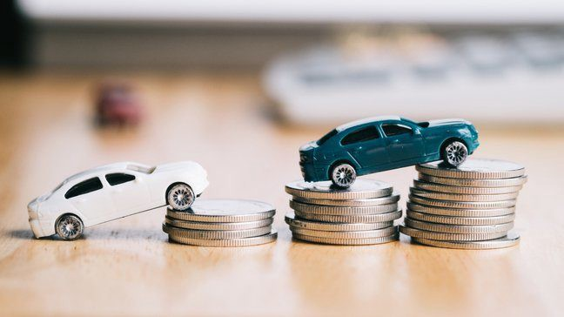
Project Presentation On “Used Car Price Prediction”
Presented By: Mr. Chris Chhotai

Slide 2
Agenda:
Overview.
Problem Statement.
Problem Understanding.
What is Used Car Price Prediction?
Importance of Used Car price prediction.
Exploratory data analysis.
Visualizations.
Analysis.
Data cleaning steps.
Model Building.
Hyper Parameter Tunning.
Saving the model and predictions from saved best model.
Conclusion.

Slide 3
Overview:
In this particular presentation we will be looking on:
How to analyze the dataset of Used Car Price Prediction.
What are the EDA steps in cleaning the dataset.
Overall analysis on the problem.
Model building from cleaned dataset.
Predicting Used Car Price for saved best model.

Slide 4
Problem Statement:
We've seen a lot of changes in the car market as a result of the Covid 19's impact. Some cars are in high demand, making them expensive, while others are not, making them less expensive. One of our clients sells secondhand automobiles through tiny traders. Our customer is having issues with their previous car price estimation machine learning models due to market changes caused by the impact of Covid 19. As a result, they're on the lookout for new machine learning models based on new data. We need to create a model for valuing automobiles. There are two phases to this project.
Data Collection Phase: At least 5000 used car data must be scraped. You can also scrape more data if you want to. The more data there is, the better the model. You must scrape the data of used automobiles from websites in this area (Olx, cardekho, Cars24 etc.) For this, you'll need to use web scraping. You must collect data from various sites. The amount of data columns is limitless; it's entirely up to you and your imagination. Brand, model, variant, manufacture year, driven kilometres, fuel, number of owners, location, and the objective variable Price of the car are the most common columns. Include all sorts of vehicles in your data, such as SUVs, sedans, coupes, minivans, and hatchbacks.
Model Construction: After gathering data, you must construct a machine learning model. Complete all data pre-processing processes prior to developing the model. Experiment with several models and hyper parameters to find the optimum model.

Slide 5
Problem Understanding:
Many people have been interested in the used automobile market at some point in their lives because they wanted to sell or acquire a used vehicle. It's a great mistake to pay too much or sell for less than the market value in this process.
The outcomes of this study may be of interest to one of the largest target groups. Used car vendors that have a better understanding of what makes a car popular and what are the most significant attributes for a used automobile may take this information into account and provide better service.

Slide 6

What is Used Car Price Prediction?
Because of rising new automobile prices and buyers' inability to afford them, used car sales are on the rise all around the world. As a result, there is a pressing need for a Used Car Price Prediction system that accurately analyses the car's worthiness based on a range of factors.

Slide 7

Importance of Used Car Price Prediction.
The manufacturer sets the price of new cars in the industry, with the government incurring some additional costs in the form of taxes. Customers who purchase a new car may rest comfortable that the money they spend will be well spent. However, due to rising new car prices and customers' inability to purchase new cars due to a lack of cash, used car sales are on the rise worldwide. A used car price prediction system is needed to accurately estimate the car's worthiness based on a range of factors. While there are websites that provide this service, their forecast approach may not be the most accurate. Moreover, several models and techniques may aid in forecasting power for determining the true market value of a used automobile When purchasing and selling, it's critical to understand their true market value.

Slide 8
Exploratory Data Analysis:
As a first step I have scrapped all the required information from cardekho website.
I have imported required libraries and I have imported the dataset which was in excel format.
Then I did all the statistical analysis like checking shape, nunique, value counts, info etc…..
While checking for null values I found null values in the dataset and I replaced them using imputation technique.
I have also droped Unnamed:0, cargo_volume and Insp_score column as I found they are useless.
Next as a part of feature extraction I converted the data types of all the columns and I have extracted usefull information from the raw dataset. Thinking that this data will help us more than raw data.

Slide 9
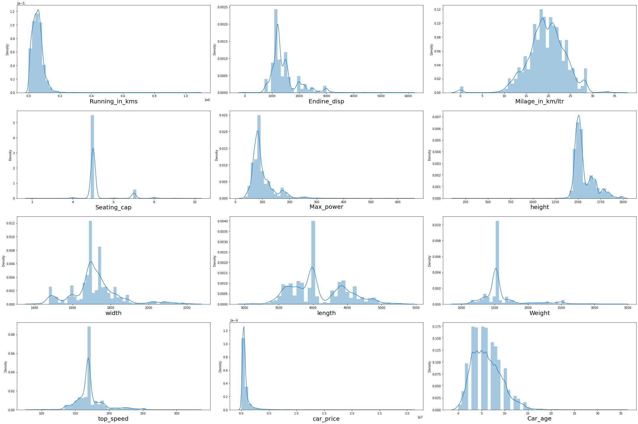
Univariate Visualization of numerical columns:

Slide 10
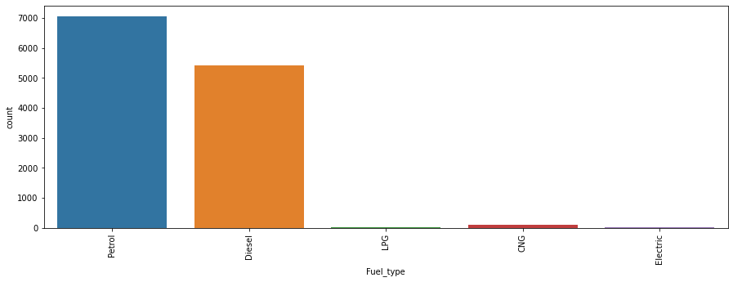
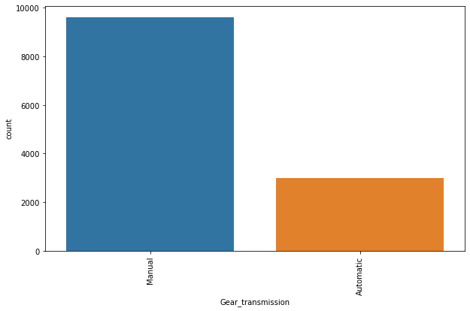
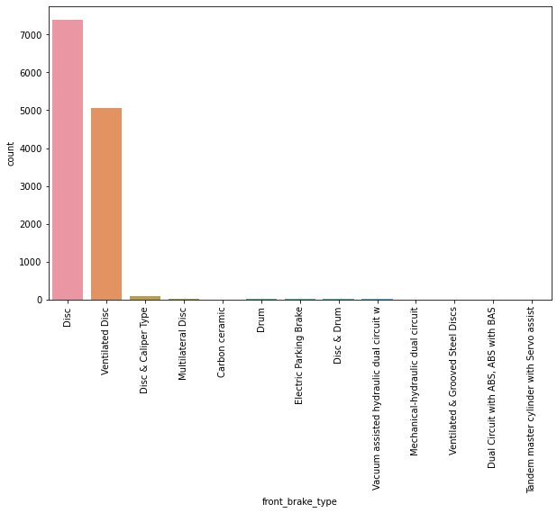
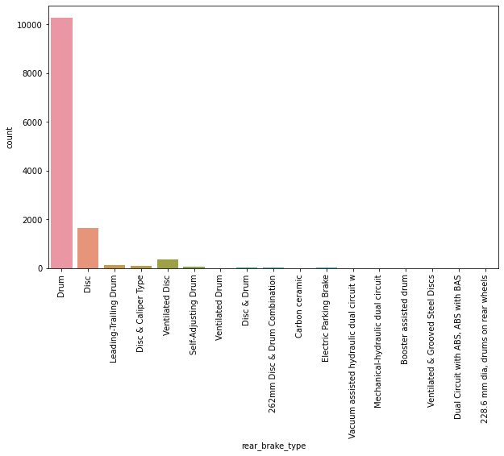
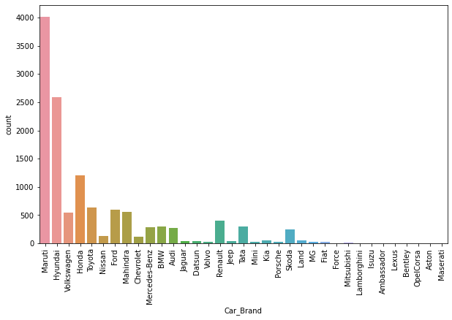
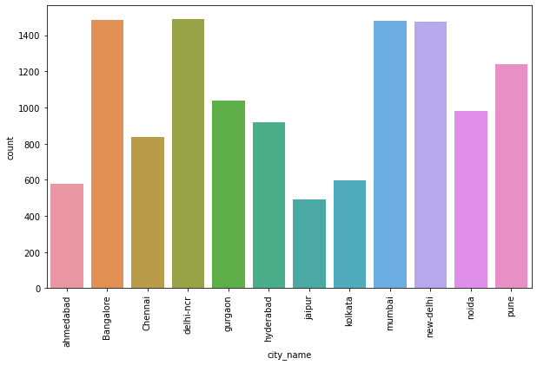
Univariate Vizualization of Categorical columns:

Slide 11
Observations:
Univariate numerical columns:
We can easily see that majority of the columns are skewed, so we must address them using appropriate approaches.
Univariate categorical columns:
The majority of automobiles are powered by gasoline or diesel.
The majority of automobiles have a manual transmission.
Cars with Disc front brakes are more common, followed by those with Ventilated Disc.
The number of drum unusual break autos is increasing.
Maruti Suzuki has the most cars on the market, followed by Hyundai.
We can find the most automobiles for sale in Bangalore, Delhi-NCR, Mumbai, and New Delhi. Because these are the most inhabited areas.

Slide 12
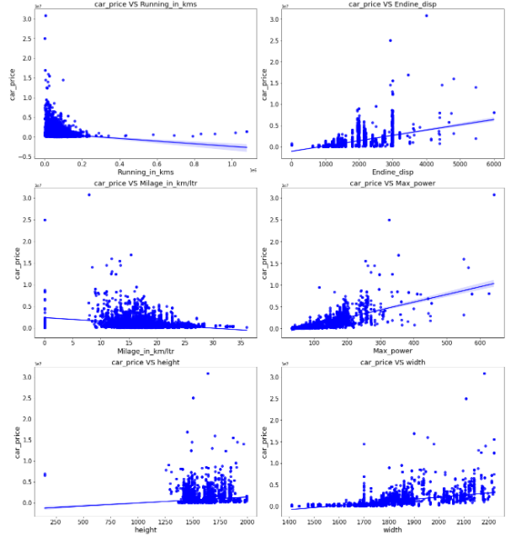
Bivariate Vizualization of numerical columns:

Slide 13
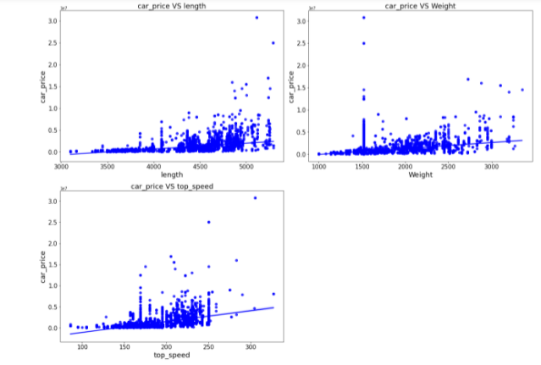
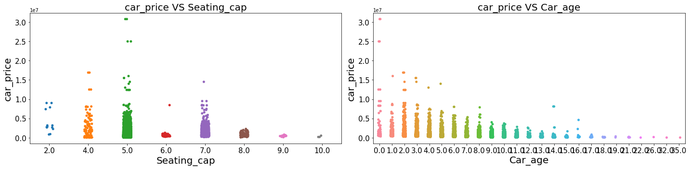
Bivariate Vizualization of numerical columns:

Slide 14
Observations:
The majority of cars have fewer than 20 thousand kilometres travelled on them. And the cost of an automobile is expensive if it hasn't been driven much.
The majority of automobiles have 1000-3000 Endine disp. In addition, the price of a 3000 Endine disp automobile is quite high.
The majority of autos have a mileage of 10 to 25 kilometres. Also, milage has nothing to do with the cost of a car.
The price of a car rises in tandem with the increase in Max power.
The car price has no relationship with height.
The price of a car rises in tandem with its breadth.
The cost of a car rises in tandem with the length of the vehicle.
The price of a car is likewise proportional to its weight.
As top speed rises, so does the price of a car.
Cars with 5 and 4 seats are the most expensive.
The price of a car lowers as the age of the vehicle grows.

Slide 15
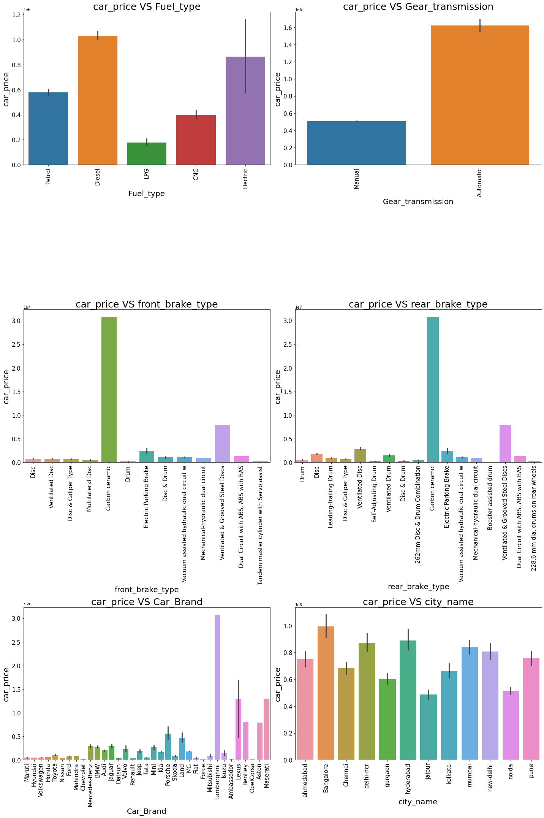
Bivariate Vizualization of categorical columns:

Slide 16
Observations:
Diesel and electric cars are more expensive than gasoline, LPG, and CNG.
Automobiles with automatic transmissions are more expensive than those with manual transmissions.
Carbon Ceramic front brakes are more expensive than other types of brakes.
Carbon Ceramic rear breaks are more expensive than other types of rear breaks.
The sale price of Lamborghini cars is the highest.
Because Bangalore, Hyderabad, and Delhi-NCR are densely populated cities, car rates are high..

Slide 17
Analysis:
To verify for skewness in numerical columns, I utilised dist plot..
For each categorical characteristic, I utilised a bar plot to show the relationship between the median automobile price and all of the subcategories inside that categorical feature.
Also for numerical variables that are continuous. To demonstrate the relationship between a continuous numerical variable and a target variable, I utilised a reg plot and a strip.
I discovered a linear link between a continuous numerical variable and the price of a car.

Slide 18
Data Cleaning Steps:
Data has been scrapped from cardekho website so we have to clean it for our convenience.
In my datasets I found null values, outliers and also skewness.
I have used imputation method to replace null values. To remove outliers I have used Z-score method. And to remove skewness I have used yeo-johnson method.
To encode the categorical columns I have use Label Encoding.
Use of Pearson’s correlation coefficient to check the correlation between dependent and independent features.
Also I have used standardization. Then followed by model building with all regression algorithms.

Slide 19
Model Building:
Because my aim was Car Price, which was a continuous column, this particular problem was a regression problem. And I built my model using all regression approaches. I discovered DecisionTreeRegressor as the best model with the least difference by looking at the difference between the r2 score and the cross validation score. We must also run many models to obtain the best model, and we must use cross validation to avoid overfitting confusion. The regression algorithms I utilised in my project are listed below.
RandomForestRegressor
GradientBoostingRegressor
DecisionTreeRegressor
BaggingRegressor

Slide 20
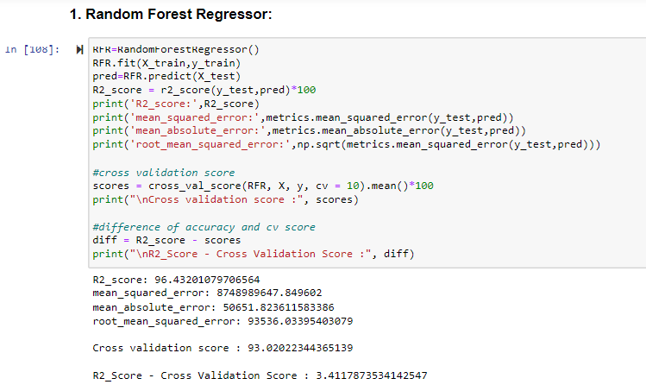
1) RandomForestRegressor:
RandomForestRegressor has given me 96.46% r2_score and the difference between r2_score and cross validation score is 3.41%, but still we have to look into multiple models.

Slide 21
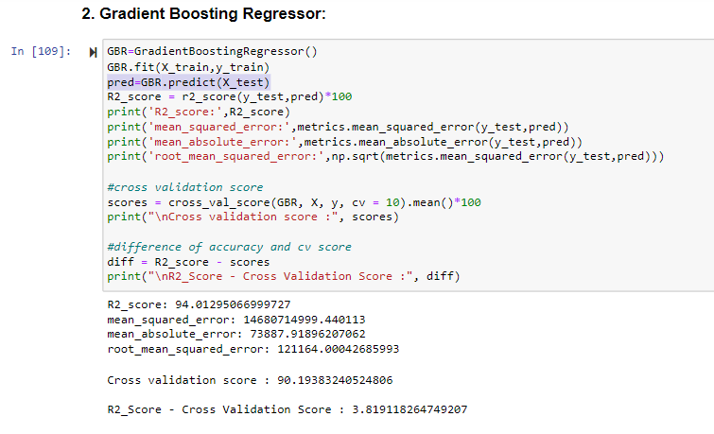
2) GradientBoostingRegressor:
GradientBoostingRegressor is giving me 94.01% r2_score and the difference between r2_score and cross validation score is 3.81%.

Slide 22
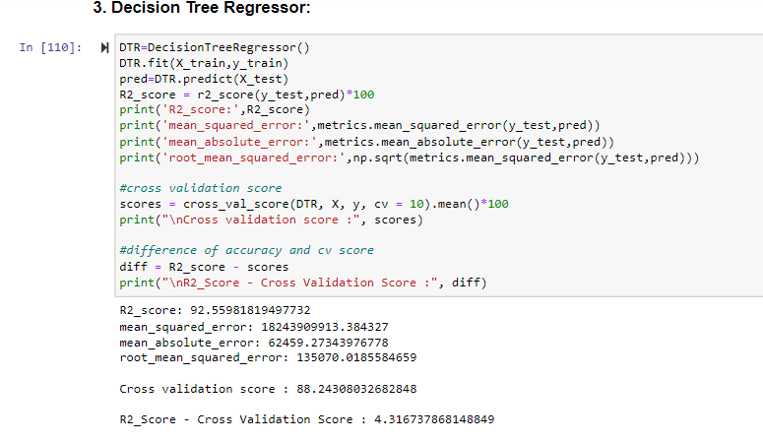
3) DecisionTreeRegressor:
DecisionTreeRegressor is giving me 92.55% r2_score and the difference between r2_score and cross validation score is 4.13%.

Slide 23
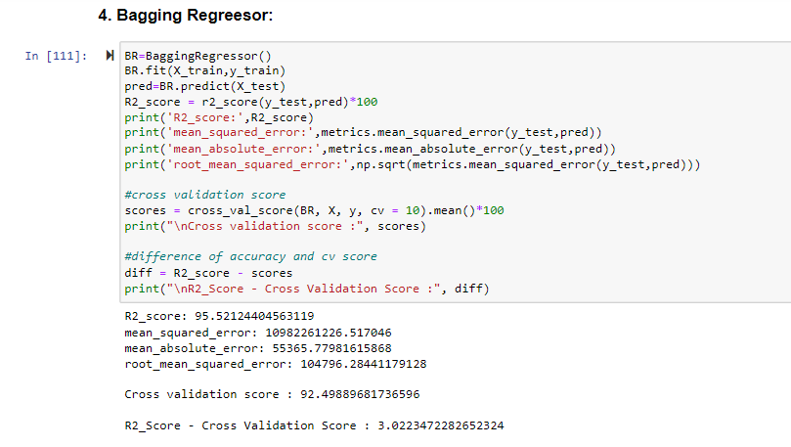
4) BaggingRegressor:
BaggingRegressor is giving me 95.52% r2_score and the difference between r2_score and cross validation score is 3.02%.
By looking into the difference of r2_score and cross validation score i found DecisionTreeRegressor as the best model with 91.79% r2_score and the difference between r2_score and cross validation score is 2.96%.

Slide 24
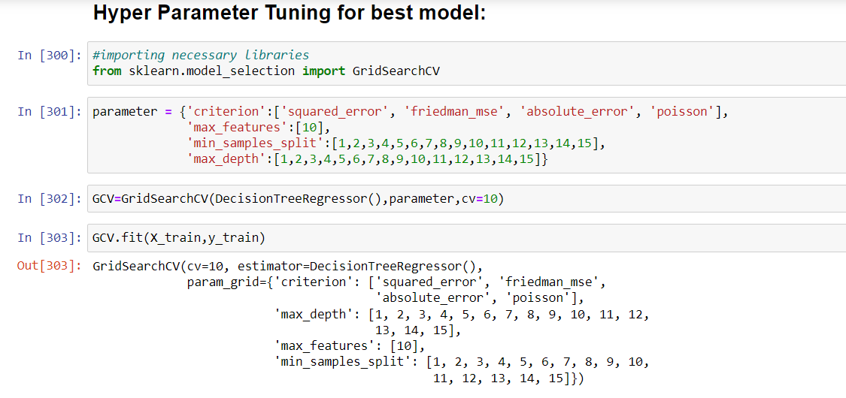
Hyper Parameter Tunning:

Slide 25
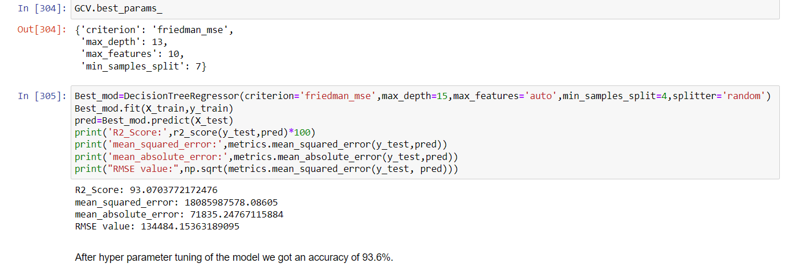
Hyper Parameter Tunning:
I have choosed all parameters of DecisionTreeRegressor, after tunning the model with best parameters I have incresed my model accuracy from 92.55% to 93.6%.

Slide 26
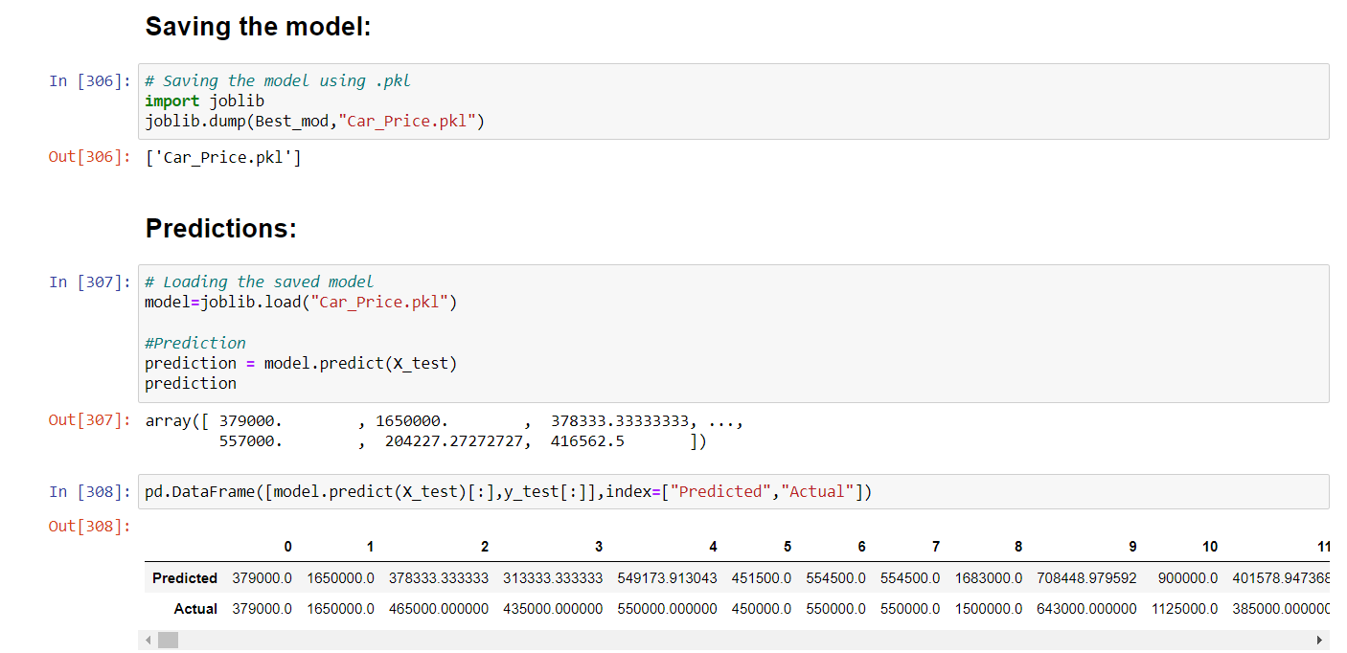
Saving the model and predictions using saved model:
I have saved my best model using .pkl as follows.
Now after saving the best model, loading my saved model and predicting the price values.
I have predicted the Car Price using saved model, and the predictions look good. The Predicted values are almost same as actual values.

Slide 27
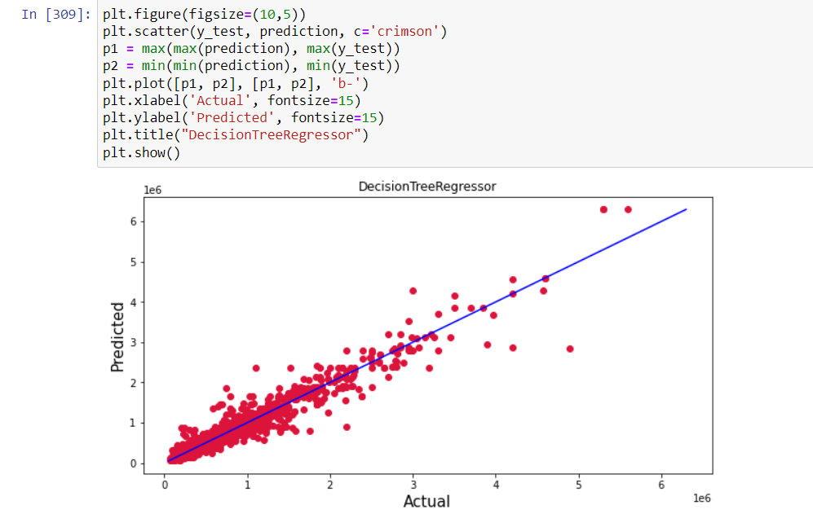
Ploting the predicted values v/s actual values:
Plotting Actual vs Predicted, To get better insight. Bule line is the actual line and red dots are the predicted values.

Slide 28
Conclusion:
We employed machine learning methods to forecast the price of a used car in our project report. The process for analysing the dataset and determining the correlation between the features has been described in detail.
As a result, we can choose traits that are both connected and independent in nature. The power of visualisation has aided us in comprehending data through graphical representation, and it has helped me understand what data is attempting to communicate.
One of the most crucial phases in removing false and unneeded values is data cleaning.
These feature sets were then fed into five algorithms, with the best model undergoing hyper parameter tuning, resulting in increased accuracy. As a result, we calculated each model's performance using several performance measures and compared them using these criteria.
The best model was then saved, and the automobile price was forecasted. The fact that the projected and actual values were nearly identical was a plus.
To summarise, machine learning's application in car price prediction is still in its early stages. We hope that this research has made a tiny step forward in terms of giving methodological and empirical contributions to online platforms, as well as introducing an alternate approach to used automobile pricing valuation.
Incorporating extra used automobile data from a bigger economic background with more attributes could be a future study path.

Slide 29


